Slide 1

The Arkansas Scholars Program
Supported by:
The Arkansas Business & Education Alliance
(ABEA) and
Your Local Chamber of Commerce

Slide 2

Arkansas Scholars
It’s for YOU!!!

Slide 3



U.S. students spend 175 days a year in school
Global Competition
Other nations’ students spend up to 220 days a year in school

Slide 4

Fact
It is estimated that over 90% of the 30 fastest growing jobs will require additional education or training beyond high school.
U.S. Department of Labor (2010 - 2020)
Will you be ready?
Notes:
Insert a map of your country.

Slide 5
Typical Life Span
Critical
period
= 48
= 48
= 48
= 48
0-14
“
working years
working years
”
“
”
“
working years
working years
”
”
70-90
14
Ages 22-70
18
18
18
Age
18
Age
Age
Age
Average
Average
Average
(yrs.)
Average
(yrs.)
life
life
life
life
expectancy
expectancy
expectancy
expectancy
Notes:
Insert a picture of one of the geographic features of your country.

Slide 6
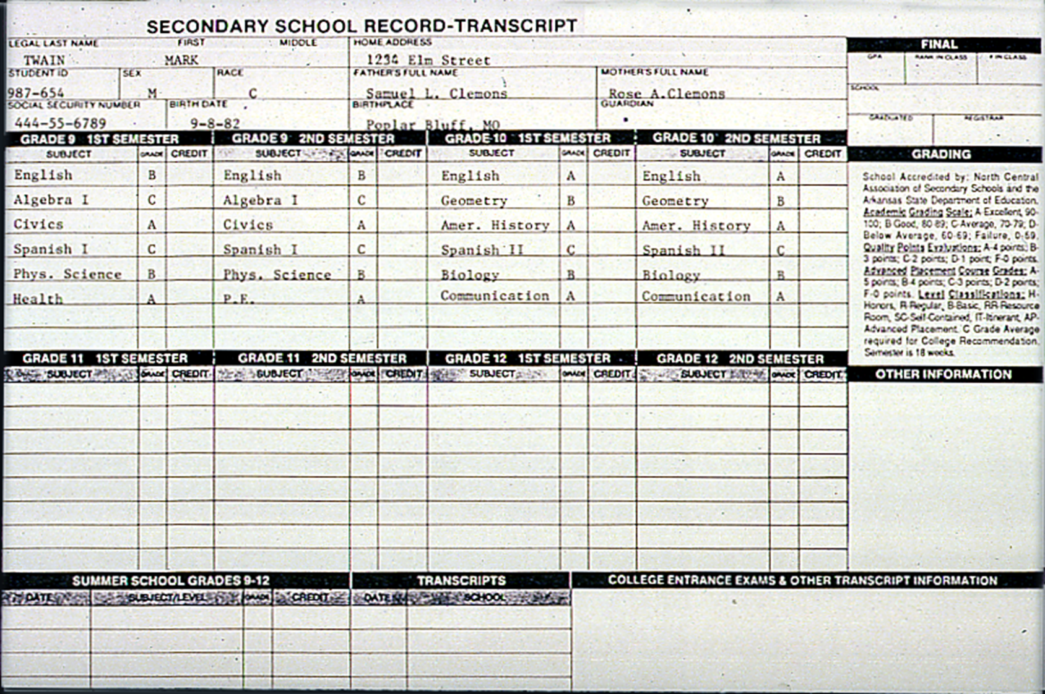
High School Transcript
9th – 12th Grades Record

Slide 7

Prepare Now for YOUR Future!
The next four years are the best chance you have to determine your future.

Slide 8
In Just Four Short Years You Will Be Doing One of These:
You will be attending college or technical school.
You will be working either part-time or full-time.
You will have or may be considering joining the military.
Or you may be unemployed…

Slide 9
Can You Succeed in Life?
The level of education that you have will have a direct impact on the level of income that you are potentially able to earn.
Ever wonder why so many people seem to struggle to make a living and yet some don’t?
Education will provide a return-on-investment to you for the remainder of your life.

Slide 10
How Can I Invest in My Education?
Choose to become an Arkansas Scholar (sign up today)
Ask your parents to remind you to do your homework
Make “C’s” or better in all your subjects
Go to class
Listen
Take good notes
Ask questions when you don’t understand something
Talk with other students about your course work
Do your homework and ask for help when needed
Study or prepare for exams (it matters)
If you will do these 10 things, you will be on a path for success in school and in life after graduation.

Slide 11
Real Life Scenario
What would it be like to have a job right out of high school making $11.33 per hour?
Let’s look at a budget of $1,963 per month.

Slide 12
Budget for a $1,963 Monthly Salary
Expense Amount Remaining
Federal Income Tax 324 1,639
State Income Tax 86 1,553
FICA + Medicare Tax 186 1,367
Housing (rent 1 bdr. Unfurnished) 400 967
Food 225 742
Car Payment 200 542
Insurance 80 462
Gasoline 60 402
Phone 40 362
Utilities 140 222
Clothing 22 200
Entertainment 60 140
Savings 30 110
Personal Items 30 80
Medical Expense 20 60
Furniture, TV, and Appliances 30 30
Miscellaneous 30 0
What can you do about this problem?

Slide 13

Earn a Higher Income!
Let’s take a look at what various careers with different educational requirements earn.

Slide 14
Jobs Requiring A High School Diploma
Annual Hourly
Waiter / Waitress $17,580 $8.45
Construction Labor 24,260 11.66
File Clerk 22,750 10.94
Security Guard 22,150 9.69
Carpenter’s Helper 25,410 12.22
Healthcare Aid 17,860 8.59
Production Worker 28,910 13.90
Tire Repair 23,050 11.08
Machine Operator (Skilled) 30,870 14.84
Food Production 18,610 8.95
Nursing Attendant 21,030 10.11
Note: Statistics provided by www.discoverarkansas.net (2013)

Slide 15
Careers Requiring High School + 1 Year of Technical School or On-the-Job Training
Annual Hourly
Emergency Medical Technician $27,040 $13.00
Licensed Practical Nurse 35,530 17.08
Welder 33.860 16.28
Carpenter 32,680 15.71
Home Appliance Repair 32,280 15.52
Plumber 38,600 18.56
Electrician 41,970 20.18
Corrections Officer / Jailer 31,500 15.14
Fire Fighter 31,110 14.96
Police Officer 35,750 17.19
Truck Driver 33,660 16.18
Note: Statistics provided by www.discoverarkansas.net (2013)

Slide 16
Careers Available With an Associates Degree (AA) or Technical Training
Annual Hourly
Medical Records Technician $30,500 $14.66
Drafting Technician 41,470 19.93
Medical Transcriptionist 29,180 14.02
Telecomm Line Installer/Repair 37,210 17.89
Respiratory Therapist 47,800 22.98
Avionics Technician 38,930 18.71
Dental Hygienist 63,670 30.61
Paralegal 37,130 17.85
Electrical Line Repair 49,260 23.68
Food Service Manager 46,400 22.30
Tool & Die Maker 40,240 19.35
Note: Statistics provided by www.discoverarkansas.net (2013)

Slide 17
Careers Requiring a Bachelor’s Degree
Annual Hourly
Health Social Worker $43,820 $21.07
Human Resource Manager 84,760 40.75
Teacher (High School) 45,880 22.06
Registered Nurse (RN) 55,240 26.56
Bank Loan Officer 61,580 29.61
Accountant 57,020 27.41
Graphic Designer 34,710 16.69
Personal Financial Advisor 61,000 29.33
Computer Programmer 65,560 31.52
Mechanical Engineer 69,300 33.32
Civil Engineer 70,050 33.68
Game & Fish Warden 45,050 21.66
Note: Statistics provided by www.discoverarkansas.net (2013)

Slide 18

Careers Requiring an Advanced Degree
Annual
        Veterinarian $83,160
        Pharmacist 114,420
        Chemical Engineer 78,000
        Architect 105,170
        Lawyer 87,050
        Industrial Production Manager 73,110
        Chief Executive Officer 142,180
        Physician 168,850
        Occupational Therapist 80,740
        Physical Therapist 79,120
Note: Statistics provided by www.discoverarkansas.net (2013)

Slide 19
Employers Hire & Promote People Who:
Took challenging courses in high school - not the minimum
Speak and write well
Have good science and math skills
Think! (have good critical thinking skills)
Have strong computer skills
Work well as part of a team
Have developed a good work ethic and a “Can Do” attitude

Slide 20
The Next Four Years Will Make a Difference in Your Future!
It doesn’t matter what kind of grades you’ve made
in the past, you can decide now to become a
good student and do well in high school.
  Will it be hard work? Probably!
  Will it be worth it? Definitely!
  What could it mean for me? Hundreds of Thousands of Dollars!

Slide 21




YOU Can Be an Arkansas Scholar!
Success comes at a price. A good education will pay you back for the rest of your life!

Slide 22


Show Me the Money!
Average Salaries by Education Level
High School Dropout: $24,544
High School Graduate: $33,852
Some College (no degree): $37,804
Associate’s Degree: $40,404
Bachelor’s Degree: $57,616
Master’s Degree: $69,108
Professional Degree: $89,128
Note: Bureau of Labor Statistics “Education Pays 2013”
On average those who complete college earn almost $1 million more than high school graduates over the course of a lifetime.
Notes:
Insert a picture illustrating a season in your country.

Slide 23
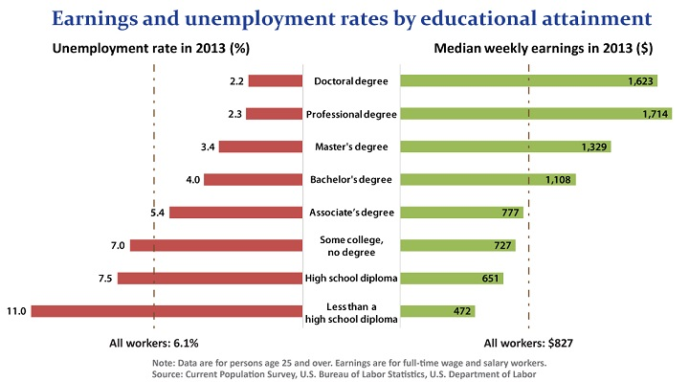

Slide 24







Slide 25

What You Have To Do To Become An Arkansas Scholar….
Take the Smart Core curriculum during high school (Requirements: Four Units of Math and English – Three Units of Science and Social Studies – Complete Remaining Courses)
Make a semester grade of “C” or better in all academic courses
Attend school at least 95% of the time or more
Complete high school in eight consecutive semesters

Slide 26


What’s In It
For You?
More choices for education after high school
More opportunities for good jobs
More money to buy the things you want
More control over your future

Slide 27
What’s in it for you?
An Opportunity to receive the Academic Challenge Scholarship…
This scholarship can help students reduce the expense of college and can even put money in their pocket.
It is open to all students attending Arkansas public or private schools.
Requirements:
Graduate from an Arkansas High School and have a minimum GPA of 2.5 with Smart Core or have a minimum ACT score 19
You can do this!

Slide 28
What’s In It For You?
Academic Competitiveness Grants (ACG)
Students who are Pell Grant eligible, a U.S. Citizen enrolled full-time, and have participated in a rigorous high school course of study like the Smart Core, may qualify for:
  Up to $750 for first year college students
  Up to $1,300 for second year college students
  Simply check that you were a “State Scholar Graduate” on your Free Application for Federal Student Aid form to see if you qualify.

Slide 29


As An Arkansas Scholar, You Will Be Better Prepared For…
Work
Technical School
College
But most importantly, you will be prepared for…

Slide 30



Slide 31


What Do You Do Now?
Make your time in the classroom COUNT!
Avoid This!

Slide 32

Do This and Enjoy the Successes that
Life Holds for You!
Decide to be an Arkansas Scholar
Take the recommended courses in high school
Don’t miss too many days of school
Do your best—make C’s or better in every class
Stay on course and graduate

Slide 33





A Program of the Arkansas Business Education Alliance & Your Local Chambers of Commerce (2015)

